Slide 1
Financial Markets

Slide 2
What are financial markets?
Buyers and sellers trade in instruments

Slide 3
Major Stock Exchanges across the countries
US
New York Stock Exchange
American Stock Exchange
Nasdaq
Europe;
London Stock Exchange (LSE)
Euro Next (Paris/Netherlands/Belgium)
Deutsche Borse (DB)
Swiss Stock Exchange (also Virt-X)
Stockholm/Copenhagen/Helsinki/Oslo (OM)
Asia:
Tokyo Stock Exchange (TSE)
Taiwan Stock Exchange
Korean Stock Exchange
Australian Stock Exchange (ASX)
Hong Kong Stock Exchange
Shanghai Stock exchange
North America
Toronto Stock Exchange (TSX)

Slide 4
Major Indices
US
S&P 500
Nasdaq Composite
Dow Jones
Europe
DAX (Germany)
FTSE100 (UK)
CAC 40 (Euro Next ,Paris)
IBEX35 (Spain's stock exchange)
Asia
Hang Seng
Nikkei 225

Slide 5
Players

Slide 6
Two sides of the trading industry
Buy side
Sell Side

Slide 7
Buy-side players
Investors
Borrowers
Hedgers
Buy side Analyst ..?

Slide 8
Sell-side players
Dealers trade for their own accounts.
Day Traders
Scalpers..( want to take advantage of small price moves)
Brokers trade for other people’s accounts.
Retail and institutional
Broker-dealers do both.
Specialists
Wire houses
Sell side Analyst

Slide 9
Facilitators
Exchanges provide systems that help traders arrange their trades.
Clearing firms/members clear and settle trades
E.g., Bear Sterns.
Clearing houses help settle trades and guarantee that traders will perform. ( NSCCL for equity and CCIL for Debt markets)
Depositories and custodians hold securities – They are clearing members but not trading members (NSDL and CDSL)

Slide 10
Facilitators..contd.
There are two depositories and approximately 288 DPs are registered with SEBI at present. The two Depositories are:
National Securities Depository Limited (NSDL for NSE)
Central Depository Services (I) Limited (CDSL for BSE)

Slide 11
Players: Motives
Investors :use the markets to move the money from present to future
Borrowers : use the markets to move the future money to present
Hedgers: Trade to manage the financial risks
Dealers/Brokers: Trade one asset for another they value more
Gamblers ; Trade to entertain themselves
Bluffers : Trade to fool and profit from uninformed investors

Slide 12
A typical set of relationships
A sponsor owns funds.
An investment manager(AMC) makes portfolio decisions.
A broker implements trade decisions.
A dealer supplies liquidity.
A clearing house guarantees the trade.
A depository holds the security.
Consultants advise everyone.

Slide 13
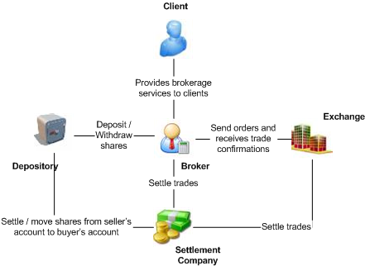
Typical trade transaction

Slide 14
Clearing and settlement process: Core Functions
Trade Recording
Trade Confirmation
Determination of obligations
Pay-in of funds and securities
Pay out of funds and securities
Risk Management

Slide 15
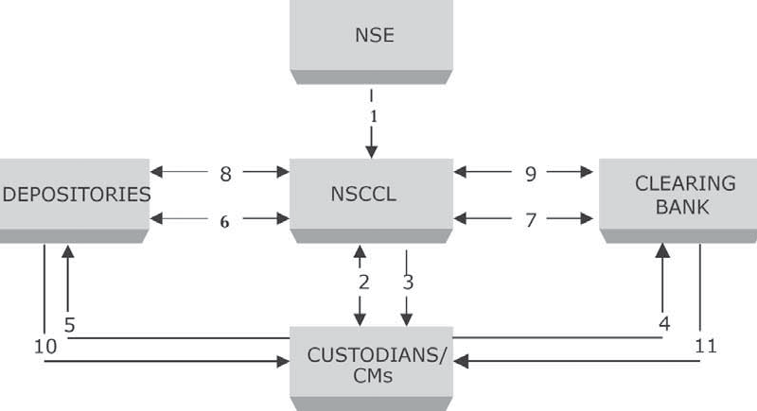
Settlement Process

Slide 16
Settlement Process
(1) Trade details from Exchange to NSCCL (real-time and end of day trade file).
(2) NSCCL notifies the consummated trade details to CMs/custodians who affirm back. Based
on the affirmation, NSCCL applies multilateral netting and determines obligations.
(3) Download of obligation and pay-in advice of funds/securities.
(4) Instructions to clearing banks to make funds available by pay-in time.
(5) Instructions to depositories to make securities available by pay-in-time.
(6) Pay-in of securities (NSCCL advises depository to debit pool account of custodians/CMs
and credit its account and depository does it).
(7) Pay-in of funds (NSCCL advises Clearing Banks to debit account of custodians/CMs and
credit its account and clearing bank does it).
(8) Pay-out of securities (NSCCL advises depository to credit pool account of custodians/
CMs and debit its account and depository does it).
(9) Pay-out of funds (NSCCL advises Clearing Banks to credit account of custodians/CMs
and debit its account and clearing bank does it).
(10) Depository informs custodians/CMs through DPs.
(11) Clearing Banks inform custodians/CMs.

